Slide 1
Network Programming Final Project
Topic ID: B2
Nguyễn Đặng Nhật Anh - 23BI14028
Nguyễn Duy Sơn - 23BI14387
Bùi Đức Minh - 23BI14305
Lê Thị Cẩm Giang - 22BA13198
Hoàng Văn Bảo - 22BA13044
Nguyễn Thái Tú - 22BA13312
Nguyễn Đình Quang - 22BA13263

Slide 2
Our goal
To implementation a multiplayer basic guessing game implemented in Python.
- Allows multiple players to join rooms.
- Guess a randomly number between 1 and 100.
- Compete to guess correctly within time limit.
The server manages game logic, client connections, and room states, while clients handle user interactions.

Slide 3
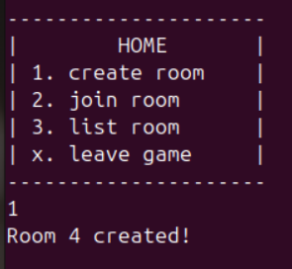
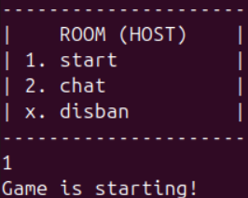
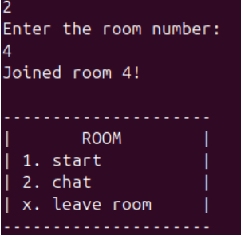
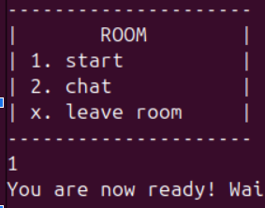
Room host
Guest

Slide 4

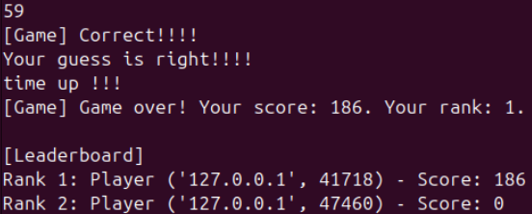
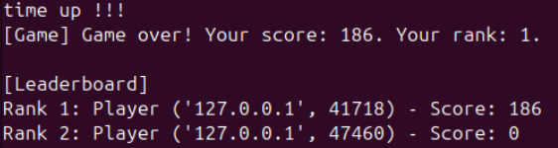
Room host
Guest

Slide 5
Table of Contents
01
02
System Architecture
Implementation
03
04
Additional Structures
Demonstration
System Architecture
About the server, client and timer
How to implementation server and client
Additionnal structures that are needed
Demonstration the game

Slide 6
01
System Architecture

Slide 7


System Architecture
Server
Client
(server.py): Manages client connections, game rooms, and game logic.
(client.py): Provides a user interface for players to interact with the server.

Slide 8
Idea
Server
Client
Socket Setup.
Game Room Management.
Player Management
Game Logic.
Message Queue
Threading.
Non-blocking Connection.
User Interaction.
Error Handling.

Slide 9
02
Implementation

Slide 10
Server
Data structure:
+ Player_list : contain all the information about the player and socket
+ Room_list: contain all the information of all the game room existed
+ game_room_message: a shared data between main function and the thread that handle game room and thread handle for the game end
Multithread:
+ Game end thread handle: change the attribute of the data structure whenever a game end in a room
+ Game room handle: handle the game for each room.

Slide 11
Server
Setup: TCP socket on 127.0.0.1:12344, non-blocking, with player_list, room_list, and game_message_queue.
Connections: select monitors sockets; new clients send usernames.
Game room: each game in a room will be handled by an unique thread.
Game Logic: Host starts game when all ready.
game_room_handle thread generates random number.
Consume messages that corresponding to the room id from game_message_queue.
sends feedback.
Game end: the game room thread will end when the game end.

Slide 12
Client
Connection: Non-blocking socket connects, sends username, enters loop.
Loop: Uses select.select to monitor the socket for server messages and sys.stdin for user input.
Errors: Handles server disconnection, connection resets.

Slide 13
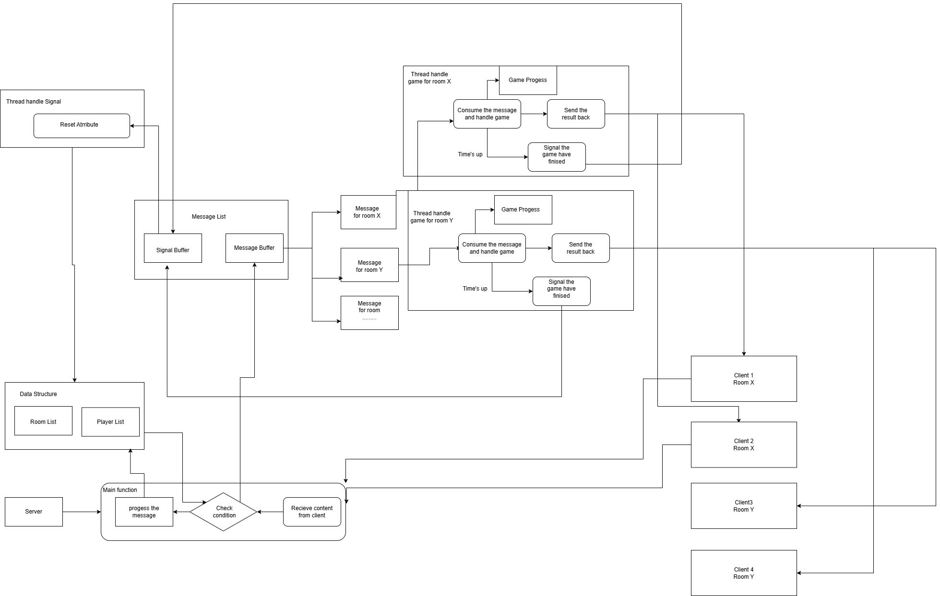
Final Implementation

Slide 14
03
Additional Structures

Slide 15
Key Classes
player.py: Stores player information.
game_progress.py: Tracks guesses, increments attempt counters and announces results.
player_list.py: Manages the list of connected players and their states.
send_menu.py: Generates context-aware menu prompts.
room_list.py: Manages game rooms, including adding/removing players and disbanding rooms.
unique_random.py: Generates unique room IDs.
game_message_queue.py: Queues and processes game-related messages.

Slide 16
04
Demonstration

Slide 17
Thanks for listening!

